Slide 1

Prolog is a logical programming language and stands for PROgramming in LOGic
Created around 1972
Preferred for AI programming and mainly used in such areas as:
  Theorem proving, expert systems, NLP, …
Logical programming is the use of mathematical logic for computer programming.

Slide 2

For symbolic, non-numeric computation
e.g. : parent (tom, bob).
Parent is a relation between its parameters: tom and bob
The whole thing is called a clause
Each clause declares one fact about a relation

Slide 3

Prolog has an interactive interpreter
After starting SWI-Prolog, the interpreter can start reading your Prolog files and accept your queries.
To exit Prolog simply type the command ‘halt.’ (Notice the full-stop)
Prolog program files usually have the extension .pl or .pro

Slide 4

There are three categories of statements in Prolog:
  Facts: Those are true statements that form the basis for the knowledge base.
  Rules: Similar to functions in procedural programming (C++, Java…) and has the form of if/then.
  Queries: Questions that are passed to the interpreter to access the knowledge base and start the program.

Slide 5

A fact is a one-line statement that ends with a full-stop.
  parent (john, bart).
  parent (barbara, bart).
  male (john).
  male (bart).
  female (barbara).

Slide 6

A Rule consists of
  a condition part (right-hand side) → body of clause
  a conclusion part (left-hand side) → head of clause
  They are separated by ‘:-’ which means ‘if’
offspring relation
  offspring (X, Y) : X is an offspring of Y
  ∀ X,Y (offspring (X, Y) ← parent (Y, X))
  offspring (X, Y) :- parent (Y, X).
head
body

Slide 7

Variables in head of rules are universally quantified
Variables appearing only in the body are existentially quantified
Rules vs. Facts
  A Fact is something unconditionally true
  Rules specify things that are true if some condition is satisfied

Slide 8

Queries are questions
The engine tries to entail the query (goal) using the Facts and Rules in KB
There are two kinds of answer
  Yes/No: parent (tom, bob).
  Unified Answer/No: parent (X, bob).
Other possible answer(s) can be
found using semicolon
(return for stopping)
For example : parent (X, Y). →
X=pam
Y=bob;
X=tom
Y=bob;
X=tom
Y=liz;
no

Slide 9

Q: Who is a grandparent of Jim? (using parent relationship)
  Who is a parent of Jim? Assuming “Y”
  Who is a parent of “Y”? Assuming “X”
  ?- parent (Y, jim) , parent (X, Y).
  If we change the order of them the logical meaning remains the same
Q: Who are Tom’s grandchildren?
Q: Are Ann and Pat siblings?

Slide 10

Facts and Rules are stored in one or more files forming our Knowledge Base
Files containing KB are loaded into the interpreter
After changing these files, the files should be loaded again to be effective
Queries are asked in the interactive mode in front of the question prompt: ?-

Slide 11
parent(X,Y) :- father(X,Y).
parent(X,Y) :- mother(X,Y).
grandparent(X,Z) :- parent(X,Y), parent(Y,Z).
ancestor(X,Z) :- parent(X,Z).
ancestor(X,Y) :- parent(X,Y), ancestor(Y,Z).
sibling(X,Y) :- mother(M,X), mother(M,Y),
father(F,X), father(F,Y), X \= Y.
cousin(X,Y) :- parent(U,X), parent(V,Y), sibling(U,V).
father(albert, jeffrey).
mother(alice, jeffrey).
father(albert, george).
mother(alice, george).
father(john, mary).
mother(sue, mary).
father(george, cindy).
mother(mary, cindy).
father(george, victor).
mother(mary, victor).

Slide 12
?- [kinship].
% kinship compiled 0.00 sec, 3,016 bytes
Yes
?- ancestor(X, cindy), sibling(X, jeffrey).
X = george ↵
Yes
?- grandparent(albert, victor).
Yes
?- cousin(alice, john).
No
?- sibling(A,B).
A = jeffrey, B = george ; ↵
A = george, B = jeffrey ; ↵
A = cindy, B = victor ; ↵
A = victor, B = cindy ; ↵
No
SWI Prolog

Slide 13

mother (X, Y) :- parent (X, Y) , female (X).
sister (X, Y) :-
parent (Z, X) ,
parent (Z, Y) ,
female (X).
What is wrong with this rule?
Any female is her own sister
Solution?

Slide 14

Multi-line :
/* This is a comment
This is another comment */
Short :
% This is also a comment

Slide 15

consult (filename).
  Reads and compiles a Prolog source file
  consult ('/home/user/prolog/sample.pl').
reconsult (filename).
  Reconsult a changed source files.
  reconsult('/home/user/prolog/sample.pl').
[‘filename’].
  ['/home/user/prolog/sample.pl'].
make.
  Reconsult all changed source files.

Slide 16

Terms in Prolog:
  Simple
    Constants:
      Atoms
      Numbers
        Integer
        Real
    Variables
  Complex Structures

Slide 17

They should consist of the following set of characters:
  The upper-case letters
  The lower-case letters
  The digits
  The special characters: +, -, *, /, <, >, =, :, ., &, ~, _
Atoms should not start with upper-case letters or underscore and can be followed by any set of characters.
The scope of an atom is the whole program

Slide 18

  anna, x30, x_, x___y, miss_Jones
  <---> , ==>, … , .:. , ::= (except reserved ones like :- )
  ‘Tom’ , ‘Sarah Jones’ (Useful for having an atom starting with a capital letter)

Slide 19
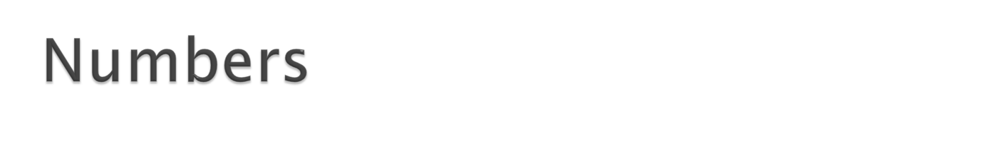
Integer
  limited to an interval between some smallest and some largest number permitted by a particular Prolog implementation
  e.g. : 1, 1001 , 0 , -98
Real
  Not frequently used
  e.g. : 3.14 , -0.0035 , 100.2

Slide 20

Consists of letters, digits and ‘_’
Starting with an upper-case or an ‘_’
The variable ‘_’ (a single underscore character) is a special one. It's called the anonymous variable.
The scope of a variable is its clause
  If the name X15 occurs in two clauses, it represents two different variables.
  Each occurrence of X15 within the same clause means the same variable

Slide 21

Compound Objects
Each constituent is a simple object or structure.
e.g. : date (1, jan, 2007)
Components can be variables.
Any day in Jan 2007 → date (Day, jan, 2007)

Slide 22

Conjunction → ,
Disjunction → ;
  P :- Q ; R.
  P :- Q
  P :- R
‘,’ has more priority
  P :- Q , R ; S , T , U .
  P :- (Q , R) ; (S , T , U) .

Slide 23

Define ancestor relation based on parent relation.
ancestor (X, Z) :-
parent (X, Z).
ancestor (X, Z) :-
parent (X,Y) , parent (Y, Z).
ancestor (X, Z) :-
parent (X, I) , parent (I, Y) , parent (Y, Z).
Solution is Recursion

Slide 24
Remember from functional programming languages
void func (int a , int b)
{
//base case
if (condition)
return;
…
// recursion
func (x, y);
…
}

Slide 25
Rules in Prolog are like functions in procedural programming languages
For recursion we should define the ancestor relation in terms of itself
Base Case :
  ancestor(X, Z) :- parent (X, Z).
Recursion Step :
  ancestor (X, Z) :- parent (X, Y) , ancestor (Y, Z).

Slide 26

Instead of starting with simple facts given in the program, prolog starts with the goals. In fact, Prolog does goal driven search.
Using rules, Prolog substitutes the current goals (which matches a rule head) with new sub-goals (the rule body), until the new sub-goals happen to be simple facts.
Prolog returns the first answer matching the query. When prolog discovers that a branch fails or if you type ‘;’ to get other answers, it backtracks to the previous node and tries to apply an alternative rule at that node.

Slide 27

Facts:
  parent (pam, bob). parent (tom, bob). parent (tom, liz).
  parent (bob, ann). parent (bob, pat). parent (pat, jim).
Rules:
  ancestor (X, Z) :- parent (X, Z).
  ancestor (X, Z) :- parent (X, Y) , ancestor (Y, Z)
?- ancestor (tom, pat). (goal)
The rule that appears first, is applied first
Unifying: {tom/X} , {pat/Z}
  The goal is replaced by : parent (tom, pat). (sub-goal)
Fails ⇒ backtracking

Slide 28

Applying the next rule
  2. ancestor (X, Z) :- parent (X, Y) , ancestor (Y, Z)
Unifying: {tom/X} , {pat/Z}
  New Goal: parent (tom, Y) , ancestor (Y, pat)
  Prolog tries to satisfy them in order in which they are written
  The first one matches one of the facts {bob/Y}
  Second sub-goal: ancestor (bob, pat)
  The same steps should be done for this sub-goal

Slide 29

ancestor (X, Z) :- parent (X, Z).
ancestor (X, Z) :- parent (X, Y) , ancestor (Y, Z).
2. ancestor (X, Z) :- parent (X, Y) , ancestor (Y, Z).
ancestor (X, Z) :- parent (X, Z).
3. ancestor (X, Z) :- parent (X, Z).
ancestor (X, Z) :- ancestor (Y, Z) , parent (X, Y).
4. ancestor (X, Z) :- ancestor (Y, Z) , parent (X, Y).
ancestor (X, Z) :- parent (X, Z).

Slide 30
It turns out that :
  The first and second variations are able to reach and answer for ancestor.
  The third sometimes can and sometimes can’t
  And the forth can never reach and answer (infinite recursion)
“Try simple things first”.

Slide 31
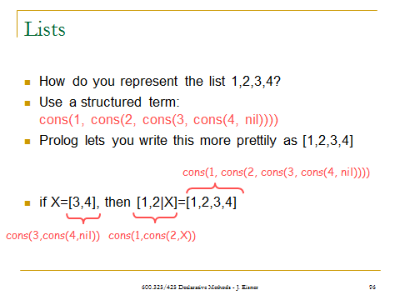

Slide 32
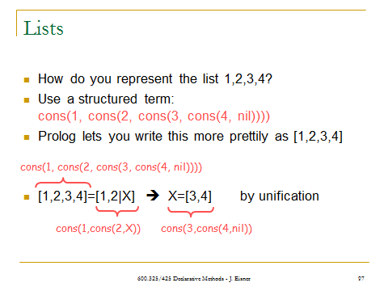

Slide 33
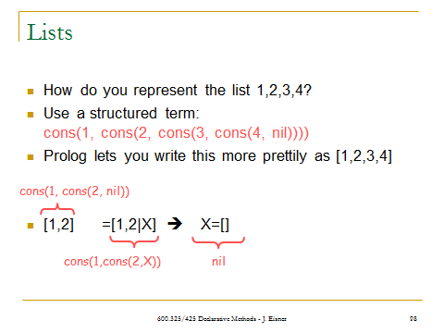

Slide 34

first(X,List) :- …?
first(X,List) :- List=[X|Xs].
  Traditional variable name:
  “X followed by some more X’s.”
first(X, [X|Xs]).
  Nicer: eliminates the single-use variable List.
first(X, [X|_]).
  Also eliminate the single-use variable Xs.

Slide 35
first(X, [X|_]).
rest(Xs, [_|Xs]).
Query: first(8, [7,8,9]).
  Answer: no
Query: first(X, [7,8,9]).
  Answer: X=7
Query: first(7, List).
  Answer: List=[7|Xs]
    (will probably print an internal var name like _G123 instead of Xs)
Query: first(7, List), rest([8,9], List).
  Answer: List=[7,8,9].
  Can you draw the structures that get unified to do this?

Slide 36
In practice, no one ever actually defines rules for “first” and “rest.”
Just do the same thing by pattern matching: write things like [X|Xs] directly in your other rules.

Slide 37

member(X,Y) should be true if X is any object, Y is a list, and X is a member of the list Y.
member(X, [X|_]). % same as “first”
member(X, [Y|Ys]) :- member(X,Ys).
Query: member(giraffe, [beaver, ant, steak(giraffe), fish]).
  Answer: no (why?)
  It’s recursive, but where is the base case???
    if (list.empty()) then return “no” % missing in Prolog??
    else if (x==list.first()) then return “yes” % like 1st Prolog rule
    else return member(x, list.rest()) % like 2nd Prolog rule
question thanks to Michael J. Ciaraldi and David Finkel

Slide 38

‘!’: Discard choice points of parent frame and frames created after the parent frame.
Always is satisfied.
Used to guarantee termination or control execution order.
i.e. in the goal :- p(X,a), !
  Only produce the 1st answer to X
  Probably only one X satisfies p and trying to find another one leads to an infinite search!
i.e. in the rule color(X,red) :- red(X), !.
  Don’t try other choices of red (mentioned above) and color if X satisfies red
  Similar to then part of a if-then-elseif

Slide 39

A ‘green’ cut
  Only improves efficiency
  e.g. to avoid additional unnecessary computation
A ‘red’ cut
  e.g. block what would be other consequences of the program
  e.g. control execution order (procedural prog.)
Fisher, J.R., Prolog Tutorial, http://www.csupomona.edu/~jrfisher/www/prolog_tutorial/contents.html

Slide 40

How to define nonsibling? Logically…
  nonsibling(X,Y) :- X = Y.
  nonsibling(X,Y) :- mother(M1,X), mother(M2,Y), M1 \= M2.
  nonsibling(X,Y) :- father(F1,X), father(F2,Y), F1 \= F2.
But if parents of X or Y are not in database?
  What is the answer of nonsibling? Can be solved by…
  nonsibling(X,Y) :- no_parent(X).
  nonsibling(X,Y) :- no_parent(Y).
  How to define no_parent?

Slide 41

Problem: There is no positive fact expressing the absence of parent.
Cause:
  Horn clauses are limited to
  C :- P1,P2,…,Pn ≡ C holds if P1^P2^…^Pn hold.
  No conclusion if P1^P2^…^Pn don’t hold!
  If, not iff

Slide 42

Solutions:
Stating all negative facts such as no_parent
  Tedious
  Error-prone
  Negative facts about sth are usually much more than positive facts about it
“Cut-fail” combination
  nonsibling(X,Y) is satisfiable if sibling(X,Y) is not (i.e. sibling(X,Y) is unsatisfiable)
  nonsibling(X,Y) :- sibling(X,Y), !, fail.
  nonsibling(X,Y).
  how to define ‘fail’ ?!

Slide 43

‘not’ predicate
  not(P) is satisfiable if P is not (i.e. is unsatisfiable).
  not(P) :- call(P), !, fail.
  not(P).
  nonsibling(X,Y) :- not( sibling(X,Y) ).
Is ‘not’ predicate the same as ‘logical negation’?

